Slide 1
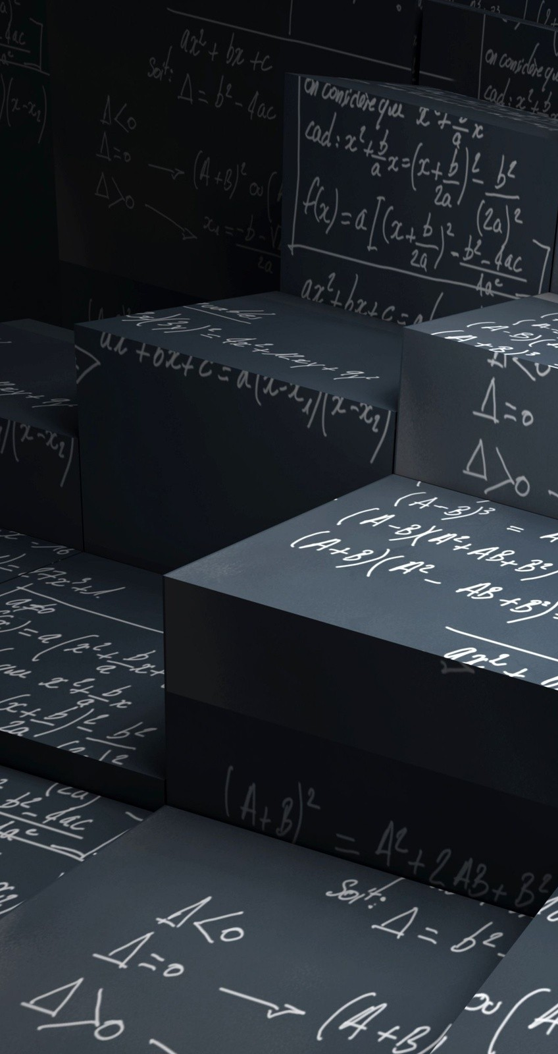
Review of Mathematics
This lesson will ensure that you have the necessary math skills to successfully complete this course. Many of the skills from grade ten math and science will be reviewed.

Slide 2
Learning Goals
By the end of this lesson, you will be able to:
solve quadratic equations
rearrange equations
apply significant digits
convert between units

Slide 3
Success Criteria
Can I:
solve quadratic eqns using the quadratic formula with a high degree of accuracy
rearranging eqns by manipulation
apply significant digits when conducting mathematical operations
convert between units by applying conversion factors

Slide 4
Solving Quadratic Equations
a quadratic equation is:
x is the variable, but in physics the variable can be Δt, θ etc. An example of a quad eqn in physics is:
a = -4.9
b = 5.0
c = 210

Slide 5
to solve a quad eqn we usually use the quadratic formula :

Slide 6
Sample Problem
Solve:
Sol’n: -4.9Δt² + 5.0Δt + 210 = 0
a = -4.9
b = 5.0
c = 210

Slide 7
PRACTICE Problem
1. Solve for Δt in the eqn:
a. 13, -11
b. -2.1, +2.8
c. 1.3, 2.2
d. -1.2, 4.8
e. 0, -1.0

Slide 8
Rearranging Equations
we rearrange eqns by manipulating one or both sides of the eqn using the rules of mathematics
what we do to one side of the eqn must be done to the other side in order to maintain the equality

Slide 9
Sample Problem
ex 2. Rearrange for b
Sol’n:
Defining the eqn
Multiply by 2
Divide by h
Rewrite the equation

Slide 10
PRACTICE Problem
2. Solve for x in the eqn:
a. b. c. d.

Slide 11
Significant Digits
Rules for Significant Digits (“Sig. Dig.”)
All nonzero digits included in a stated value are
significant. eg. 123 has three sig. dig.
2. All leading zeros are not significant.
eg. 0.00000001 has only one sig. dig.
All trailing zeros are not significant unless a decimal
place is used to make them significant.
eg. 100 has only one sig. dig.
100. has three sig. dig.
100.0 has four sig. dig.

Slide 12
In a decimal number, all trailing zeros are
significant.
eg. 0.000000010 has two sig. dig.
If a number is written in scientific notation, then all
the numbers are significant.
eg. 3.00 x 10⁸ has three sig. dig.
Any zero that is between nonzero numbers is
always significant.
eg. 106 has three sig. dig.
7. Significant digits only apply to measured values; they do not apply to counting and constants

Slide 13
PRACTICE Problem
Determine the number of sig dig in the following:
189
300
20.
1.00 x 10⁵
1001
0.00020
109.450
3.00101

Slide 14
When multiplying and/or dividing measured values, the answer must have the same amount of sig. dig. as the measurement with the fewest number of sig. dig.
When adding and/or subtracting measured values, the answer must have the same number of decimal places as the measured value with the fewest decimal places.

Slide 15
PRACTICE Problem
The dimensions of a rectangle are 12.35 cm by
8.6 cm. What is the area of the rectangle?
Two pieces of wood are glued together. The first piece has a length of 24.25 cm and the second piece has a length of 5.4 cm. What is the length of the glued board?

Slide 16
Unit Conversion
To convert between units we multiply the value by conversion factors
Convert 95 km/h to m/s
95 km/h equals 26 m/s. Notice the number of sig.
dig remains the same.
Conversions factors don’t affect the number of sig. dig.

Slide 17
PRACTICE Problem
13. What is 15 m/s in km/h?

Slide 18
A quick way to convert from km/h to m/s is use the following relationship:
1 m/s = 3.6 km/h
km/h to m/s divide by 3.6
m/s to km/h multiply by 3.6

Slide 19
HOMEWORK
Review lesson material
Are You Ready for Unit One # 1 – 8 pg 4 – 5

